Slide 1
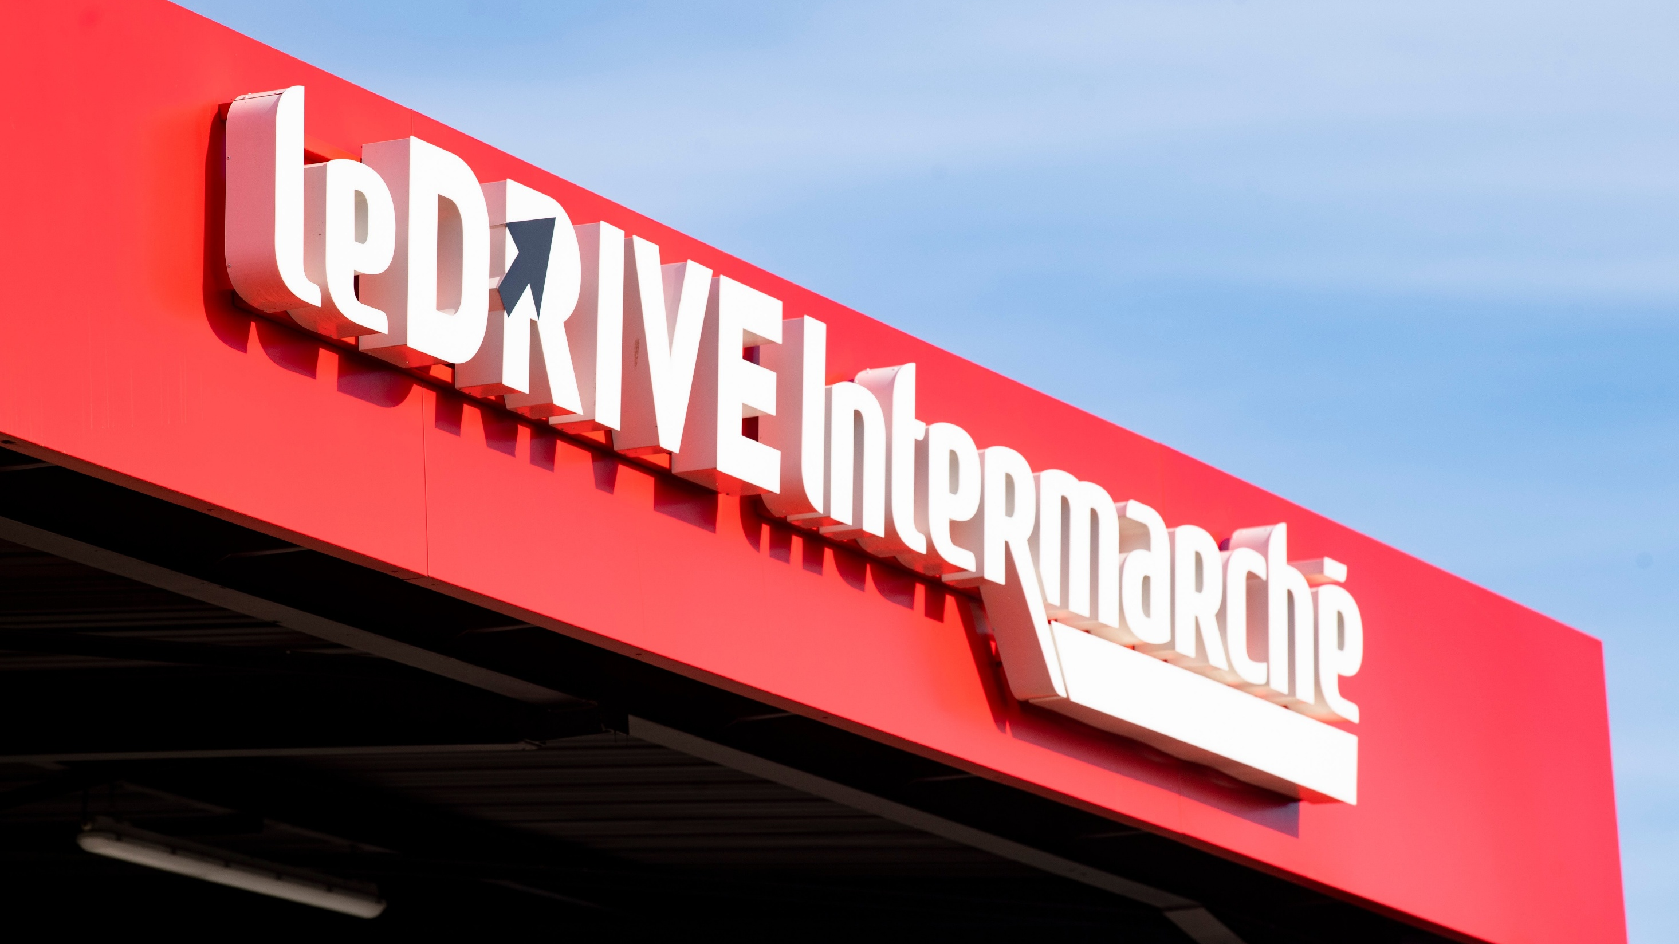

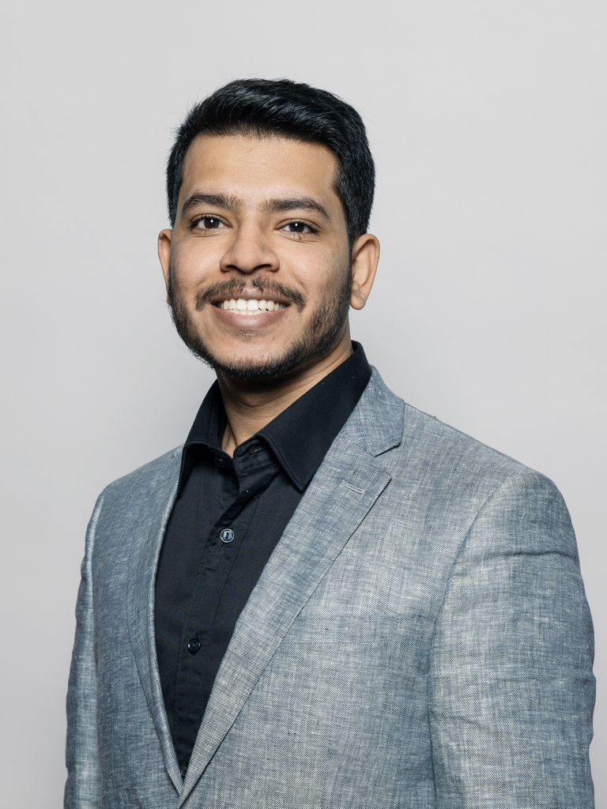
Second Value Campaign
Sustainable AI for
By Vinayak Singh

Slide 2
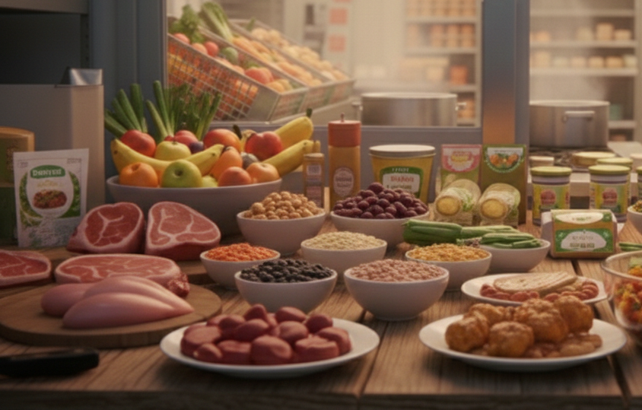
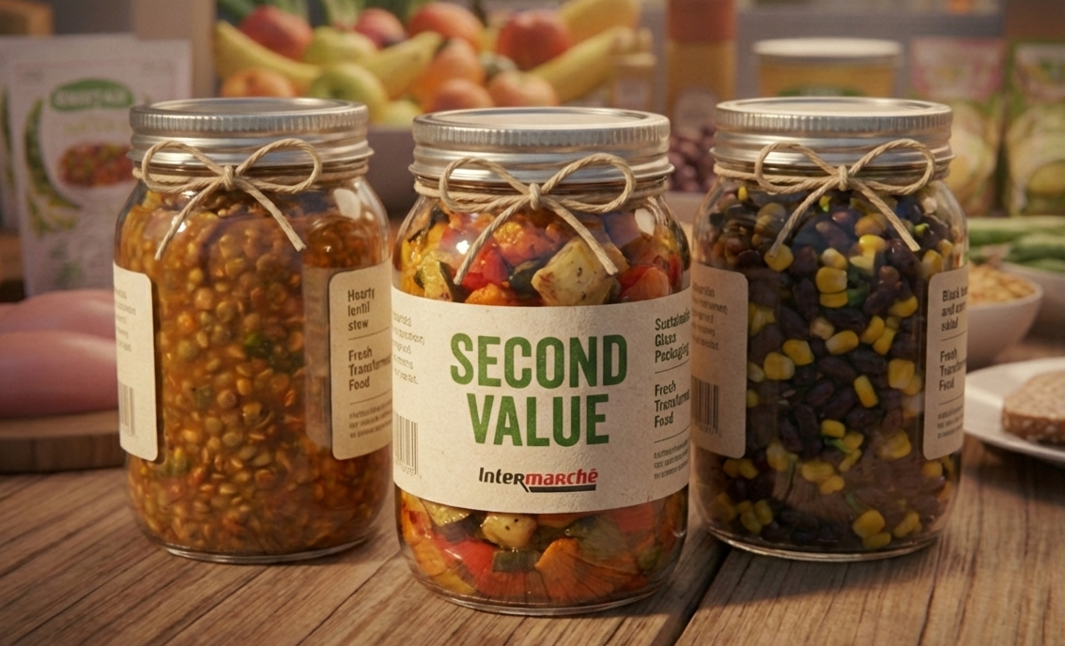
The solution: AI-powered circular ready-to-eat meals from second value fresh food
BUSINESS
Turn unsold fresh food into profitable ready-to-eat meals that drive incremental revenue and basket growth.
SUSTAINABILITY
Reduce food waste and carbon footprint by replacing industrial meals with lower-impact, in-store prepared alternatives.​
OPERATIONS/AI
Use AI to pilot inventory, recipes, and daily production with minimal additional operational complexity.
Notes:
Speaker : Linus

Slide 3
Turning 2nd value food into a high-margin revenue stream
Core Logic
My model transforms an existing loss into a new revenue stream by:
Revalorizing unsold fresh products
Transforming them into ready-to-eat meals
Selling them at market-aligned prices
Leveraging proximity and trust as differentiation
No new raw material cost
Only transformation cost
Production Costs
Revenues
Investment needed
For 200g per portion :
Unsold food → 0€ marginal cost
Labor + Packaging + energy + buffer → ~2€ total cost
Selling price €3.30–€3.40 Target margin: ~30%
€1.00–€1.30 gross margin per portion 35–40% incremental margin
Store Benchmark :
Average price in store today: €3.31
Target margin: ~30%
Gross margin per portion ≈ €1.00–€1.30 ~35–40% incremental margin
Annual projection (conservative) :
30 portions/day × 300 days = 9,000 portions/year
€10k–15k gross profit / recipe / store Scalable across categories
AI decision-support tool → €15,000
Staff training & change → €5,000
Light setup → €5,000
Total initial investment ≈ 25,000
Recurring maintenance: ~€5,000/year
ROI
Waste reduction → €30–40k/year
Anti-waste margin → €15–25k/year
Total annual impact: €45–65k Payback: 12–18 months / ROI: 1,28%
Notes:
Speaker : Hugo

Slide 4
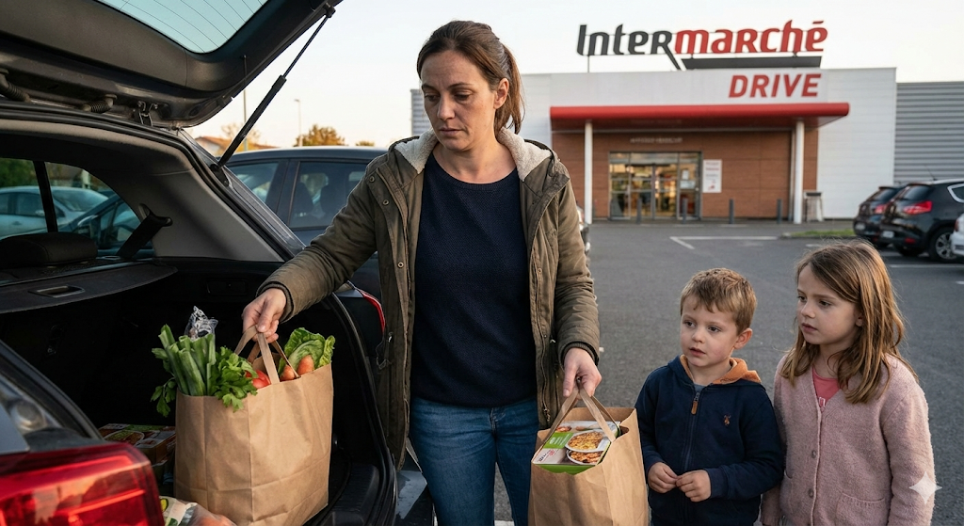
Time-poor, price-sensitive customers looking for healthy convenience
Investments Needed (Year 1)
Negative trends
Shrinking purchasing power
Lack of time
Positive trends
Zero waste
Community retail
Lisa, 34
Single mother · Hospitality worker · Intermarché Drive user
Lives <2 km from store
Needs
Affordable, healthy meals
PAIN POINTS
Relies on fast food too often
Fresh food perceived as expensive
Stress from daily meal planning
Guilt about kids’ eating habits
VALUE DRIVERS
Ready-to-eat, time-saving meals
Trust in freshness and traceability
Affordable price point
Simple availability via Intermarché Drive
Notes:
Speaker : Quitterie

Slide 5
Sustainability Impact: Turning waste into carbon savings
Carbon impact
Key success factor
1. Waste avoided (less destruction = less upstream emissions wasted)
2. Substitution effect (our meals replace industrial ready-meals)
Becoming a substitute to industrial ready-meals → CO₂ reduction
Local anti-waste meals → replace → industrial prepared meals
(short supply chain, no factory process, no long-distance transport)
Estimated CO₂ savings per year (Darnétal) ≈ 1,8 ton of CO₂ avoided / year
KPI
Without AI
With AI
Equivalent impact
Meals produced/day
Avg meal weight
Days/year
Net difference : industrial vs. local meal
Net CO₂ saved
30
200g
300
~0.2 kg CO₂/meal
1,8t
36
200g
300
~0.2 kg CO₂/meal
2,2t
2 Paris–Marseille flights (~1.2 tCO₂/flight)
11,000 km driven by a car (~0.2 kgCO₂/km)
1 household electricity / 6 months
(~4.5 tCO₂/household)
Notes:
Speaker: Emma

Slide 6
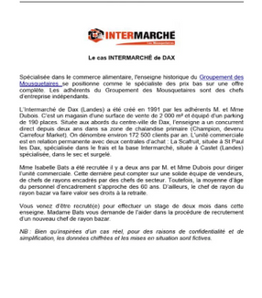
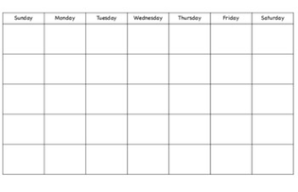
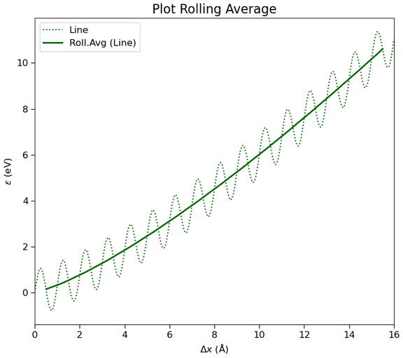
IA – the enablerle of content
JOB DESCRIPTION
RECAP CASSE MENSUELLE
Lag Time : 3 Weeks
High Volume Waste
Rolling Avg
Actual Demand
High Admin Load
Fresh Rescue
Waste Monetization Engine
Market Pulse
Dynamic Pricing & Demand
Precision Order
Advanced Procurement
Trend Scout
Promotional Optimization
Workforce Efficiency
The Manager’s Copilot
Tech Stack : Gen AI (LLMs) | Time-Series Forecasting (TFT) | Computer Vision (YOLOv8)
Notes:
IA integration in the project:
Inventory checking
Pricing
Provide relevant recipes regarding food available in the next year
To track food trends from social media to be on page and make buzz
Production/forecast
Promotions planning
Staff management
Advertising
Compute etiquette and carbon bilan for each meals
Faire la liste des produits
Prouver qu’il y aura une vraie substitution

Slide 7


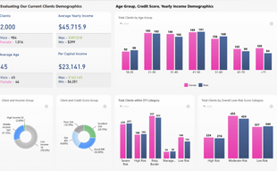
IA tech stack: the hands, the brain and the eyes
Contextual Data
Weather + Calendar
Historical Data 5 Years
Market Potential
PDF Injections
Structured Processing
Unstructured Processing
SALFORD & CO.
📊
📚
🧩
⚖️
🛠️
👍
TFT Model Engine
Temporal Fusion Transformers(TFT)
Generative LLMs & Reinforcement Learning
Optimized Order Quantity
Store ERP (sales/Inv)
IoT Sensors (Fridges)
External Web
Unified Architecture: Integrating structured CSVs with unstructured PDFs/Web data for holistic decision making.
Notes:
IA integration in the project:
Inventory checking
Pricing
Provide relevant recipes regarding food available in the next year
To track food trends from social media to be on page and make buzz
Production/forecast
Promotions planning
Staff management
Advertising
Compute etiquette and carbon bilan for each meals
Faire la liste des produits
Prouver qu’il y aura une vraie substitution

Slide 8
Budget and deployment of an AI tool of content
AI Implementation – Cost Overview
Initial Investment : ~ €15,000
Expert-based estimate
Competitive market pricing
Moderate complexity
Recurring Costs Maintenance & updates ➜ €400- €700/month
Usage-based micro-fees (per API request) ➜ Less than one cent per 100 requests
Companies Capable of Developing and Implementing the Solution
EKIMETRICS
ARTEFACT
CAPGEMINI
QOLAIG
...
Notes:
Speaker : Jules

Slide 9
Roadmap of content
Q2 26
Q3 26
Q4 26
Q1 27
Strategy & Audit
Clear business case + waste opportunity sizing
Framework Design
Documented store-level operating model
Development & Testing
Validated proof of concept
Market Entry & Optimization
Scalable store-level model (<12–18 months payback)
MONTH 1-3
MONTH 4-6
MONTH 7-9
MONTH 10-12
Waste & revenue baseline
Product & risk validation
Store team insights
Operating model design
Pricing & recipes setup
KPI & training preparation
Pilot counter launch
Track waste, margin, demand
Adjust volumes & pricing
Category expansion
Operations optimization
ROI & playbook
Notes:
Speaker: Sana

Slide 10
Outlook of content
Pilot Store
Optimization & Stabilization
Cluster Expansion
Automation & Regional Structuring
National Replication
PHASE 2
PHASE 4
Launch in Darnétal (30 portions/day)
Basic AI tool + staff training
Track waste, margin, sell-through
Adjust volumes to demand
Integrate into Drive
Standardize process & KPIs
Expand to 3–5 Rouen stores
Create shared local transformation hub
Short-distance logistics only
Shared AI dashboard
Standard pricing & governance
Performance tracking
Replicable local hub model
Best-practice playbook
CSR integration
PHASE 1
PHASE 3
PHASE 5
0-6 months
6-18 months
After 24 months
Year 3-4
Year 4+
Notes:
Speaker: Hugo

Slide 11
Thank you

Slide 12

Appendix

Slide 13
Stakeholder Overview
Internal Stakeholders
Stakeholder | Interest | Power | Key issues
Store owner (Virginie Decoen) | Very high | Very high | Profitability, simplicity, ROI
Department managers | High | Medium | Workload, waste, performance
Employees (shelf staff, fresh, Drive) | High | Low | Scheduling, physical strain, stability
Support functions (finance, HR) | Medium | Medium | Automation, data reliability
External Stakeholders
Stakeholder | Interest | Power | Key issues
In-store customers | High | High | Price, speed, freshness
Drive customers | High | High | Simplicity, availability
Local suppliers | Medium | Low | Volumes, predictability
ITM Group (IT / Data) | Medium | High | Data governance
Local authorities | Low | Medium | Local employment, carbon impact
Competitors (Lidl, Leclerc) | — | High | Price pressure & usage

Slide 14
Challenge & Value Proposition
Challenge Question:
How might Intermarché Darnétal recover lost revenue by turning food waste into a local competitive advantage through proximity with customers and simple operational transformation?
Value Proposition:
By transforming unsold fresh food into visible, local, ready-to-eat meals, Intermarché Darnétal turns food waste from a hidden cost into a source of trust, differentiation, and profitable growth for local customers and store teams.

Slide 15
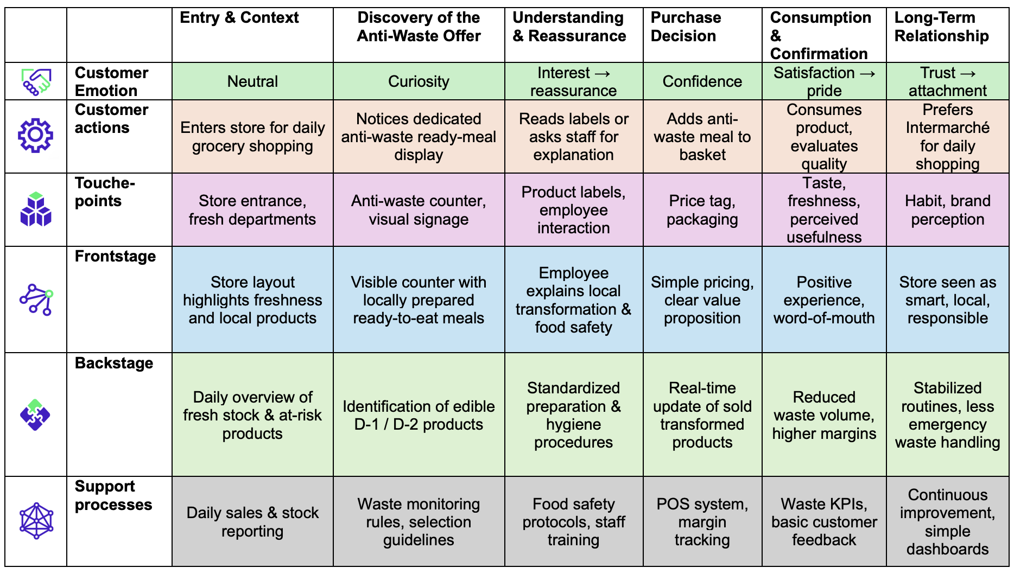
Service Blueprint

Slide 16

Advertising - Second Value
https://edheccom-my.sharepoint.com/:v:/g/personal/hugo_arab_edhec_com/IQB_CcxBh_KQQruJaSNkoYnUAZQLRSmIwg63H8jsIrfWVys?e=b0yzcd

